Slide 1

An overview of .NET Core and ASP.NET Core What is it and should your care?
Rick Strahl
West Wind Technologies
www.west-wind.com
www.west-wind.com/weblog
Session materials:
https://github.com/RickStrahl/SWFOX2019_DotnetCore

Slide 2







Rick Strahl
Big Kahuna West Wind Technologies
Author and Speaker
Popular Blog: weblog.west-wind.com
ASP.NET Insider and MVP
Tools and Components
@RickStrahl
rstrahl@west-wind.com
weblog.west-wind.com

Slide 3
.NET Core: More than a FaceLift
.NET Core is different than Full Framework
These two are separate frameworks
Different integration and hosting mechanisms
.NET Core is not tied to Windows
.NET Core changes Everything
New platform paradigm for .NET
Cross Platform
100% Open Source
Completely rearchitected infrastructure
While maintaining .NET functionality/features
Open source has created a very active developer environment

Slide 4
.NET Core and .NET Framework
Different Frameworks
Fundamentally different platforms
Full Framework is Windows Dependent
.NET Core is cross platform
Core architecture and plumbing varies greatly
Shared Features
CoreFx is .NET Core’s version of the .NET BCL/FCL
Core .NET APIs are mostly unchanged
Tooling that works for all .NET framework
.NET Framework is DONE at v4.8
Current version is the last version of full framework
All future updates to CoreFx features will be only in Core

Slide 5
.NET as a Platform not your Granny’s .NET
Many .NET’s, Common Set of Tools
.NET Core, .NET Framework, Xamarin, Mono
All can share the eco system and for separate specialties
Microsoft has re-architected .NET
Common base
Tooling, compilers, languages and runtime components
Standard Libraries
.NET Standard defines a base set of features
.NET implementations implement a version of .NET Standard
Guarantees common feature set across .NETs

Slide 6
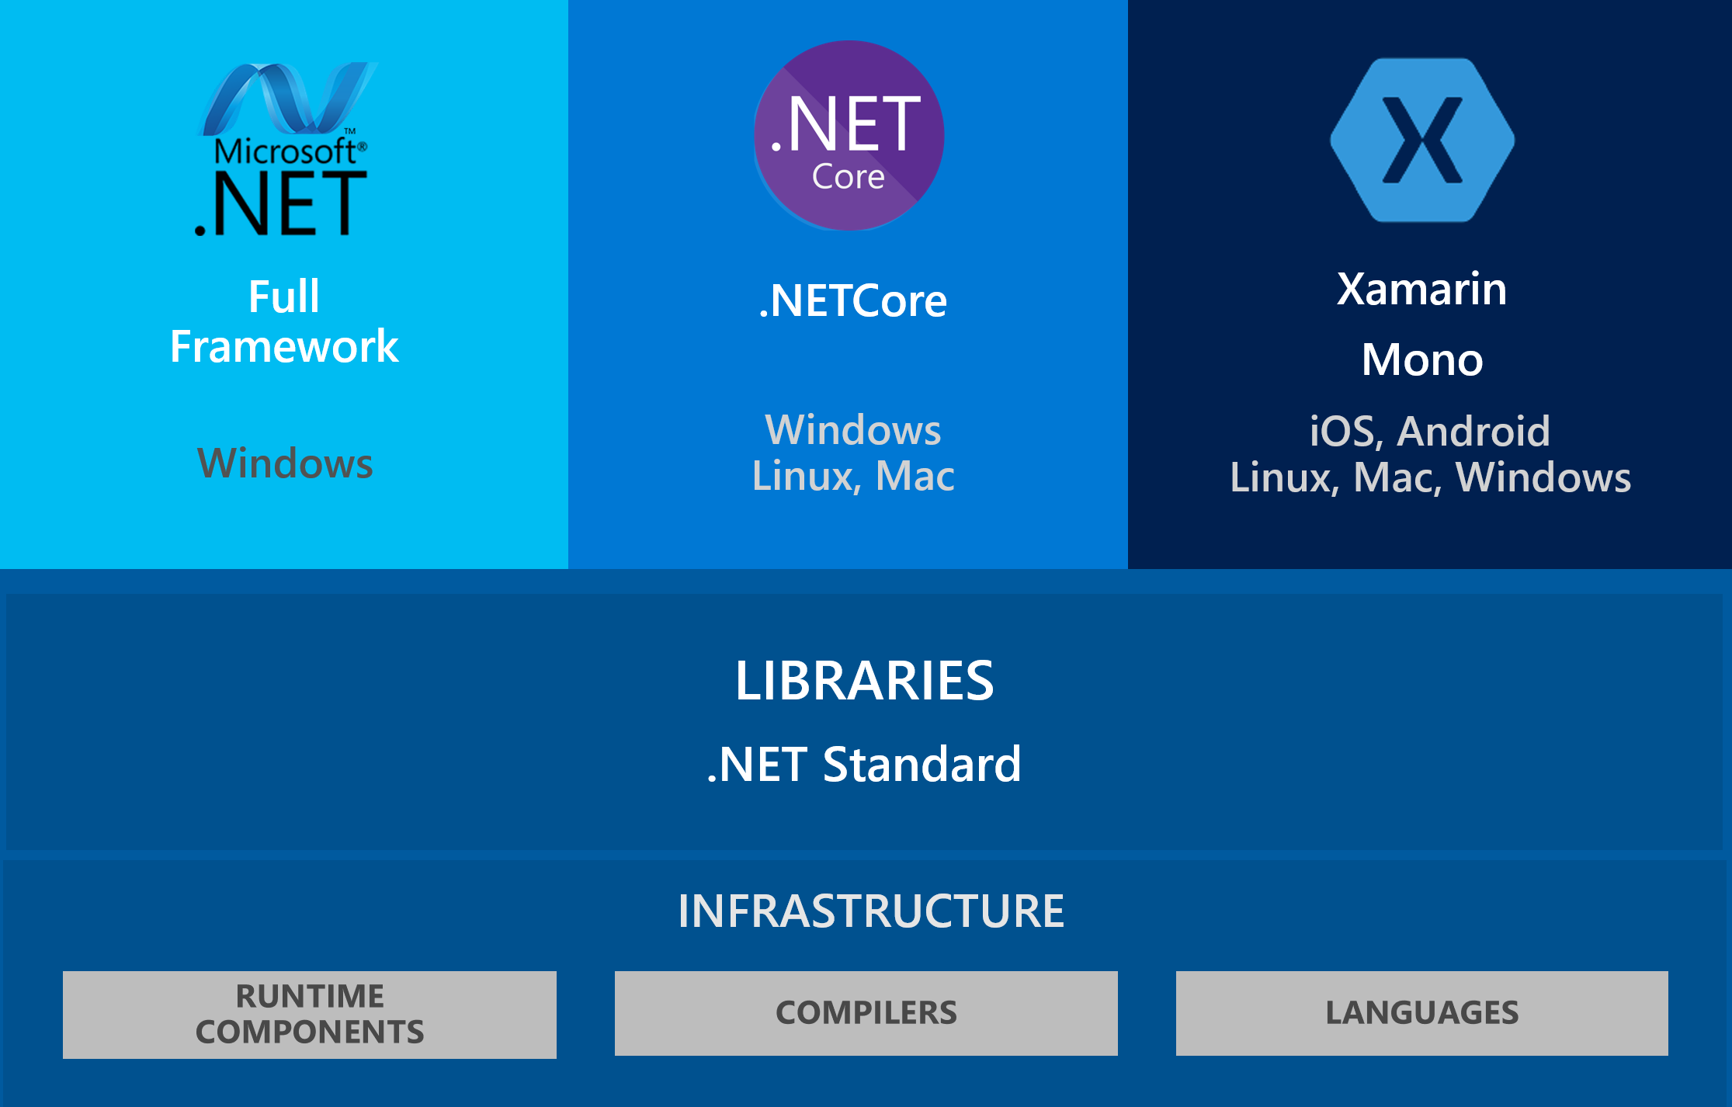
.NET as a Platform

Slide 7
.NET Feature Frameworks
Feature Frameworks sit ontop of Runtimes
ASP.NET for Web and Cloud Support
WinForms, WPF and UWP for Desktop Support
Xamarin for iOS and Android Applications
ML.NET for Machine Learning
Microsoft IoT Framework for devices
Frameworks are what make .NET Powerful
Frameworks can access all of the .NET base features
Applications are built ontop of Frameworks
Third parties can built new Frameworks

Slide 8
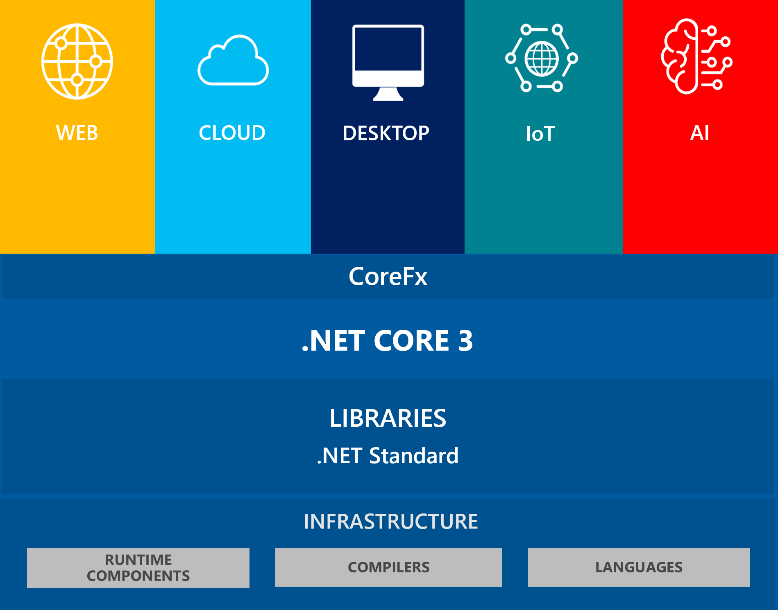
.NET Core 3.0
Stack

Slide 9
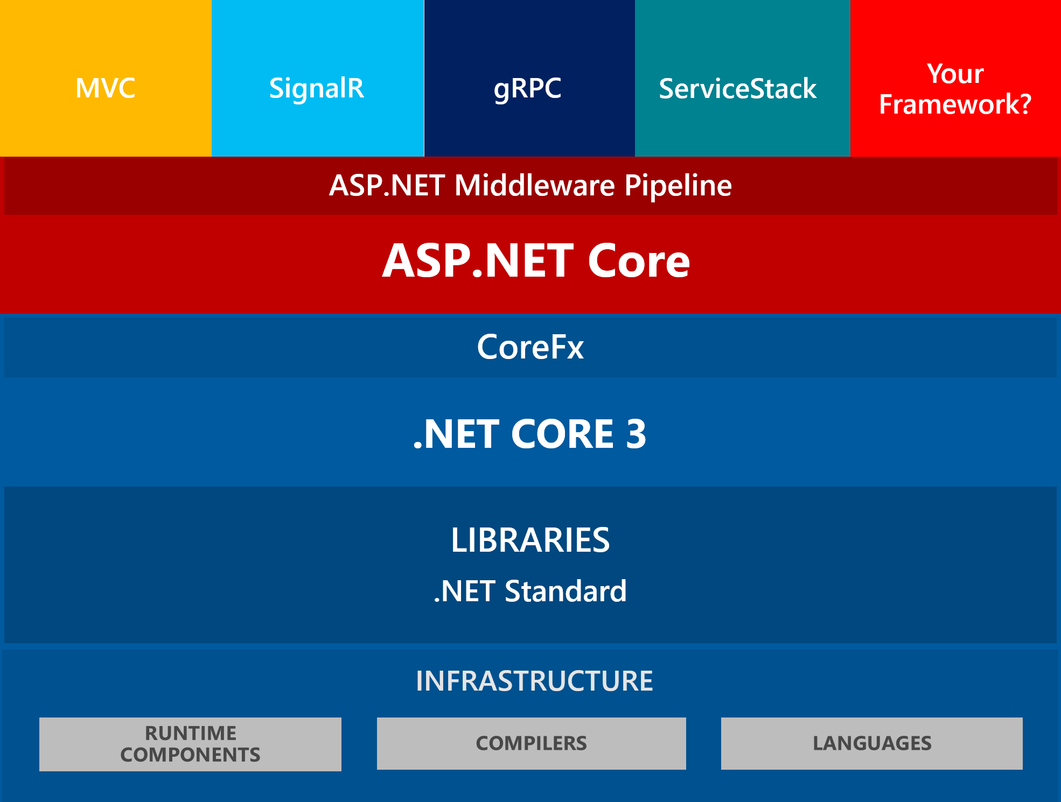
Frameworks within Frameworks

Slide 10
Tooling
Everything works from the Command Line
Dotnet command handles entire lifecyle processing
Compilation, Nuget Packages, Building, Publishing etc.
Developers can build custom tools (similar to NPM)
Can be Automated
Any application can call the compiler and build tools
It’s easy to hook build ops into your own applications
You can also build applications on the server
Or in a Docker Container
Extremely powerful compared to old MsBuild way

Slide 11
Languages and Compilers
Unified Compilation System
Supports all built-in .NET Languages (C#, VB, F#)
Same tooling to compile all languages
Projects or individual files are supported
Command Line Tooling
You can compile using the `dotnet` command
Project determines the language to use
Raw compilers are also still available but shipped with Roslyn
Compiler as a Service
Roslyn is an API
Can be integrated into applications
Means: You can create your own compiling applications
Means: You can dynamically compile code at runtime

Slide 12
.NET Standard Libraries
.NET Standard is a BluePrint
A specification of .NET Features
A specific runtime implements that specification (ie. NetStandard 2.0)
It’s about Consistency
All frameworks now implement .NET Standard 2.0
Means: You get the same .NET features from that standard in all of the supported platforms.
Means: Vendors know EXACTLY what they have to implement
It’s about Compatibility
Standard forces requirements to library vendors
If a library supports .NET Standard 2.0 you know it works on any platform that supports .NET Standard 2.0

Slide 13
.NET Runtimes
Runtimes are Implmentations of .NET
Examples: .NET Core, .NET Framework, Mono, Xamarin, Unity
A runtime is a physical implementation of .NET features
Typically based on a specific version of .NET Standard
All frameworks now support .NET Standard 2.0
All frameworks EXCEPT full Framework are moving towards 2.1
System, IL Level services
Framework Functions
Runtime hosting
Bootstrapping of CoreFx
Assembly loading/Type Resolution
OS Integration semantics (ie. IO functions/OS features)

Slide 14
CoreFx
The .NET Core Feature Libraries
CoreFx provides the user API to the underlying runtime
Plus many common platform/language features
What used to be the BCL/FCL libraries
Contains the core .NET Platform features
IO/Reflection/Serialization/Math/Strings etc.
Most of the .NET Work happen in CoreFx
CoreFx is a very large surface
This is what most developers think of as .NET
It’s the core libraries that make up .NET features

Slide 15
.NET Core 3.0
Latest Version of .NET Core
v3.0 is usually a Charm
Big performance improvements
Support for Windows Desktop Applications
WinForms and WPF can now be built with .NET Core
Self contained executables

Slide 16

ASP.net Core
the core of .NET Core

Slide 17

ASP.NET Core
ASP.NET is the 90% Use Case
Most used framework on .NET Core
Most of the investment is based around Web scenarios
Many new features are ‘dogfooded’ by ASP.NET Core
High Performance
ASP.NET Core is blazing fast compared to classic ASP.NET
Classic ASP.NET was limited by dependency on IIS
Native, very fast Kestrel Web Server
Custom server interfaces for platforms (.NET Core IIS Module)
Scores among top Web Servers for many scenarios (techempower)
Highest performance general purpose Web Application Server

Slide 18
What’s new in ASP.NET Core
High performance
Huge performance gains on already good performance
Drastically reduced memory footprint
Noticable in local development
Cross Platform
Important for Web apps
Host on Linux or Docker, and also Windows
Transparently switch between platforms
Middleware Pipeline
Powerful middleware pipeline to hook into Request lifecycle
Act on Before and After Processing handlers
Most features are hooked up as middleware
Examples:
Markdown Processing
Live Reload functionality
Custom encryption

Slide 19
Desktop Frameworks
Wpf and WinForms

Slide 20
Desktop Applications in .NET Core
New in .NET Core 3.0
Previously only Console Apps could run
By default all Console apps are cross platform
WinForm and WPF apps are Windows only!
Support for WinForms and WPF
Winforms and WPF SDKs can build desktop apps
Some differences in feature and a few missing features
Overall relatively easy to port an application to .NET Core
Windows Platform Support
Windows specific features aren’t part of .NET Core
Added via special support libraries that provide Windows features
Note: Most but not all Windows features are supported

Slide 21
Pros and Cons for .NET Core Desktop Apps vs. Framework Apps
Pros
Cons
Self contained installations
Your app is fixed and not updated by OS
Performance improvements in .NET Core
Future proof
Microsoft enhances .NET Core
Future performance gains
Open sourced WPF/WinForms might bring improvements of long neglected Frameworks
No OS pre-installed runtimes
Runtimes are large (~50mb)
A few missing Windows features

Slide 22
FoxPro and .NET Core
Interop is more complicated

Slide 23
FoxPro and .NET Core
Different Hosting Model
New Runtime Hosting APIs
New COM Host
But no Idispatch support
FoxPro -> .NET
Plain COM Interop instantiation no longer works
But wwDotnetBridge now works with .NET Core
Most features are supported
.NET Core -> FoxPro
No easy ASP.NET Core Support
No support for STA Threading
Requires a custom implementations will work
Web Connection can now run as .NET Middleware

Slide 24
Calling .NET Core from FoxPro
Built-in Idispatch COM Interop is Dead
Standard COM Invocation no longer works in .NET Core
IDispatch is currently not supported for .NET Core COM Objects
Not likely to be supporte in the future
wwDotnetBridge works
New wwDotnetCoreBridge class
Allows invocation of .NET Core classes
Otherwise works the same as full framework version
Access to most features is available
wwDotnetBridge Limitations
Can’t unload .NET Runtime once loaded
No easy way to load framework libraries (AspNetCore/WinForms/WPF)
CLEAR ALL/RELEASE ALL will kill the .NET Core Runtime
Fine for Production Applications
Problematic at Dev time if you RELEASE environment

Slide 25
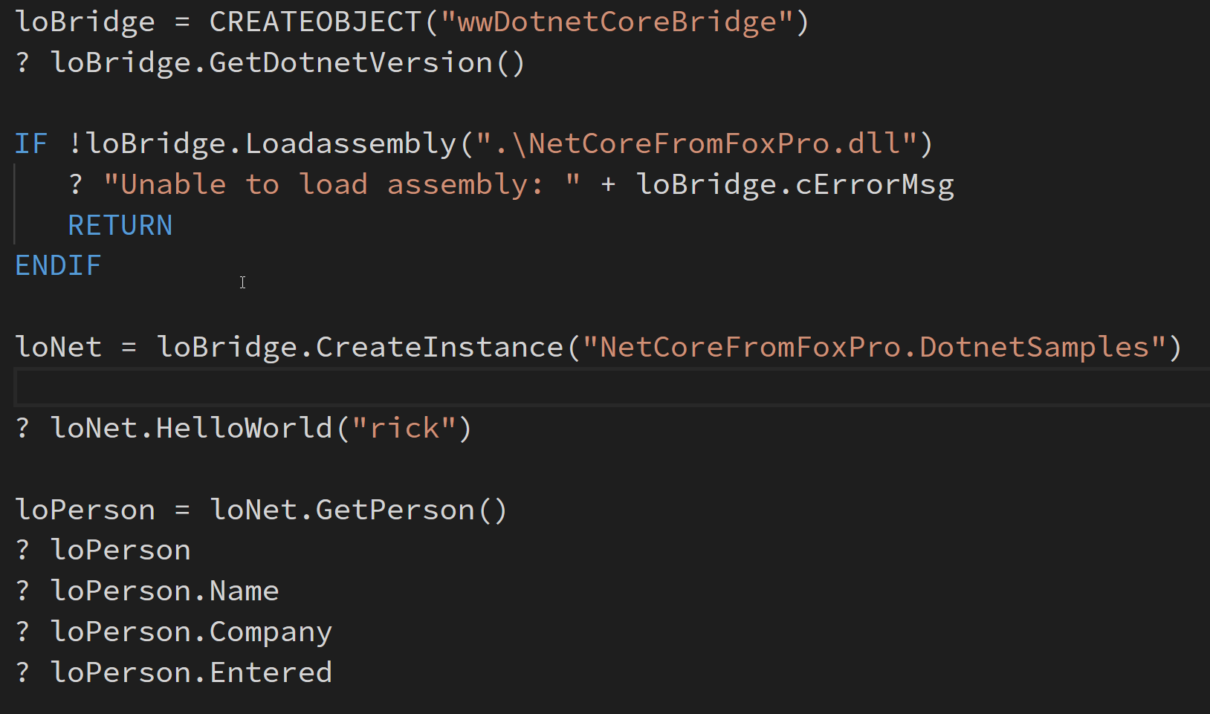
Using wwDotnetCoreBridge

Slide 26
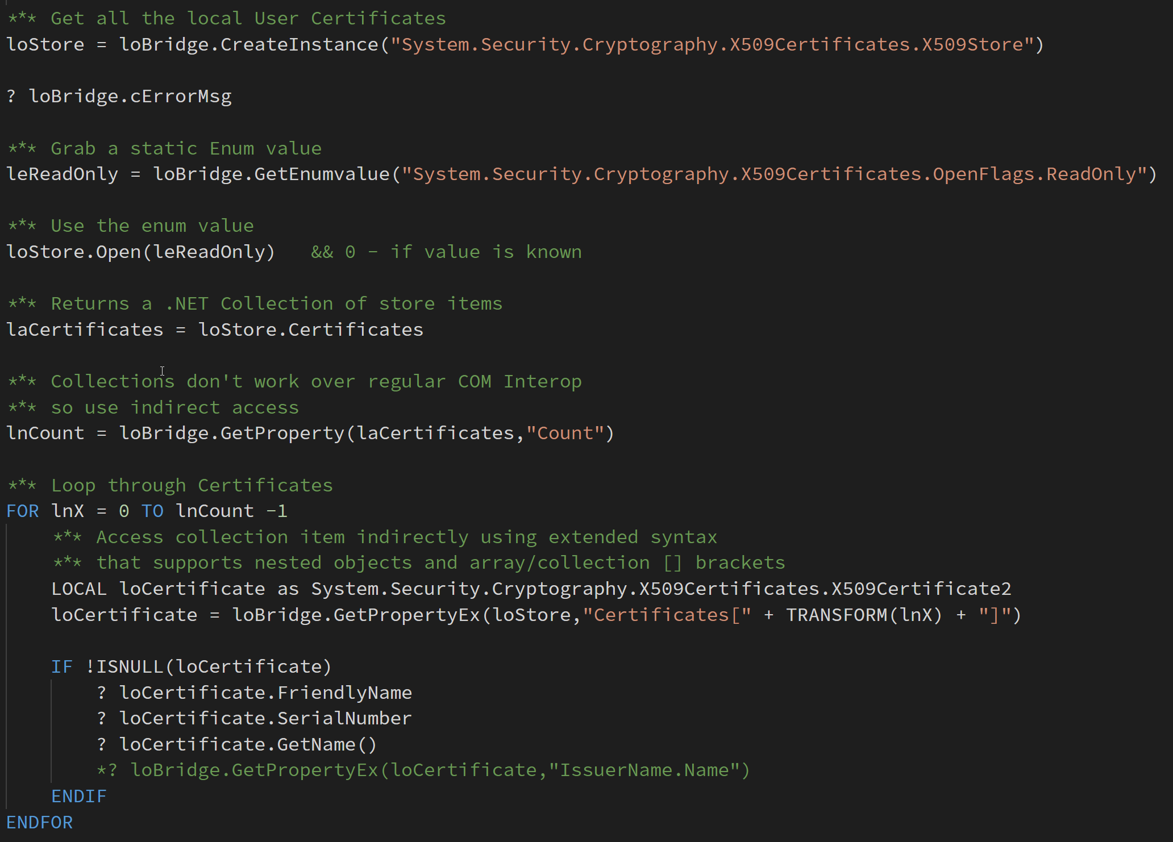
Using wwDotnetCoreBridge

Slide 27
ASP.NET Core and FoxPro
No STA Thread support in ASP.nET Core
Web Server uses MTA Threads
Web Server is heavily using Async code
FoxPro COM Servers require STA threading
MTA threads will corrupt FoxPro Server State
COM is supported, but…
In ASP.NET Core it requires a custom Thread pool
No native support for that is available

Slide 28
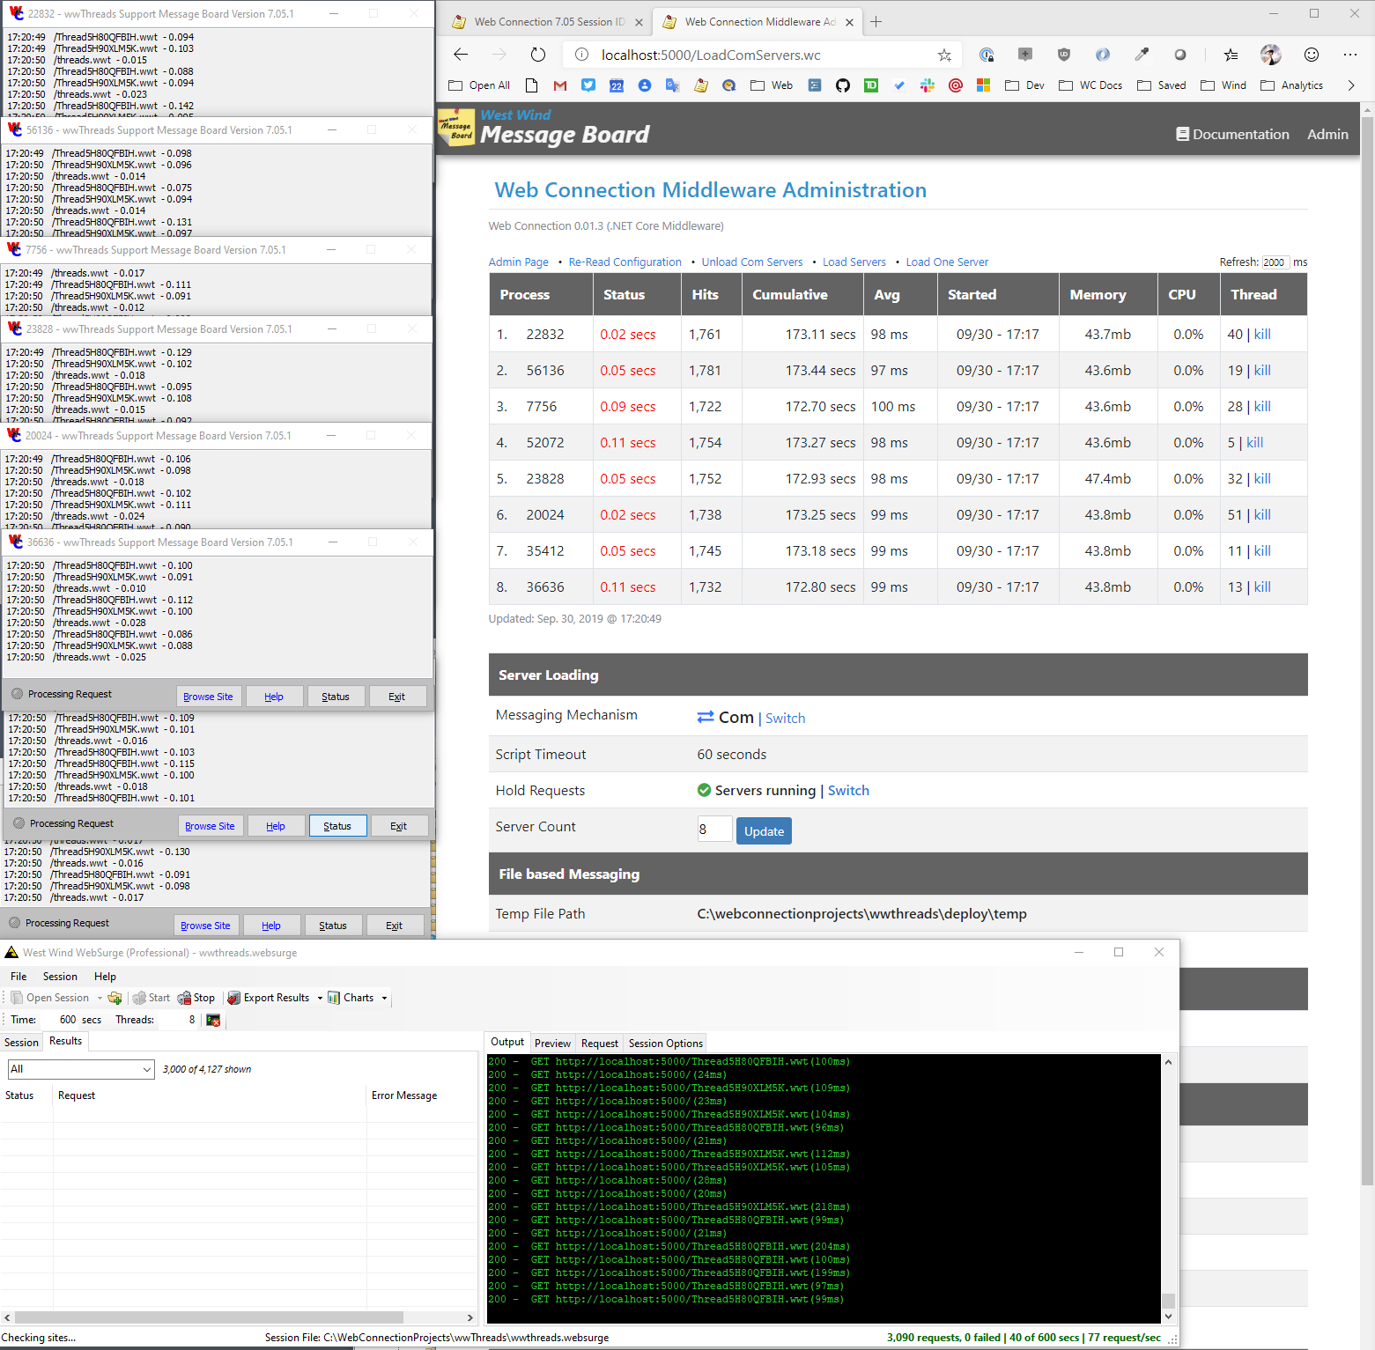
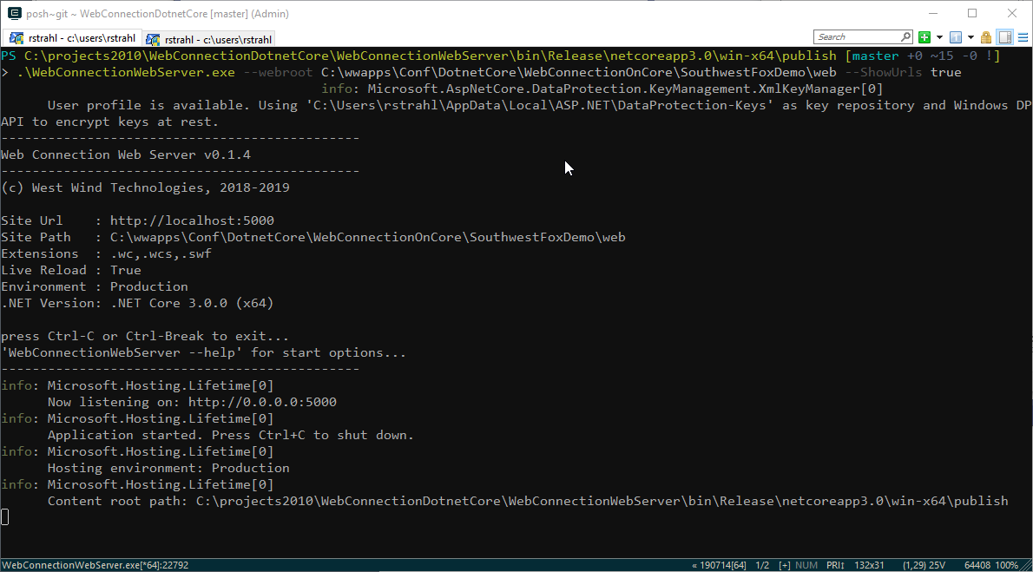
Web Connection on .NET Core
Implemented as Middleware
Shifted .NET Handler code base to Middleware
90% of the code base was portable
The rest was the plumbing hookup code
Standalone Web Server
Implemented as Dotnet Tool
Or as Self Contained EXE (no dependencies)
Server can be hosted in IIS
Supports 64 bit server operation
Development Server Enhancements
Self contained – no IIS dependency
Can be run from the Command Line
Includes built-in Live Reload functionality
Built-in Live Reload Server
Compatible with IIS hosting
Use DevServer during dev, host full .NET for live
Or host Middleware server directly with IIS

Slide 29

Web Connection Web Server
Installable as a Dotnet Tool
Or run as a (large) Standalone Executable
Can run as a standalone Exe
Can run as an IIS hosted .NET Core handler
Standalone server is large (~50mb)
But: Has no external dependencies

Slide 30
Summary
.NET Core is a Modern Platform
High Performance
Cross Platform
.NET Core is Different, yet Similar
Architecturally different from Full Framework
But uses same .NET base libraries you may already know
ASP.NET Core has many changes, but same concepts
Upgrading to .NET Core requires a bit of work
.NET Core is Microsoft’s Future
.NET Full Framework is done at version 4.8
All new development goes into .NET Core
4.8 will be supported for a long time!!!

Slide 31
Summary
ASP.NET Core and FoxPro don’t mix
No STA Threading Support
Async code and MTA can’t marshal FoxPro objects
Web Connection supports .NET Core via custom Threading
COM is supported in .NET
You can create FoxPro COM objects in .NET
COM Interop for .NET object invocation is broken
But you can use wwDotnetBridge to access .NET Core Components

Slide 32
Thank you!
Resources
Github: Source Code, White Paper and Slides https://github.com/RickStrahl/SWFOX2019_DotnetCore
Contact Rick
@RickStrahl on Twitter
https://weblog.west-wind.com
https://west-wind.com/wconnect/weblog/
rstrahl@west-wind.com

